Slide 1
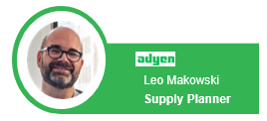
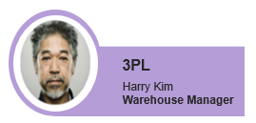


TERMINAL-DISTRIBUTOR - Inventory Management - Architecture
System Roles:
Inbound PO
Purchase Order
Sales Order
Super User/Role
Terminals as serial numbers
LOT
TERMINAL-DISTRIBUTOR Key User/Role
Terminals as received
Staged
Key loaded
Available
Shipped out
Received customer
Returned
Repair
Etc.
Stage SET
Stage SET
3PL User/Role
Stage SET
Stage SET
Repair Centre User/Role
Transaction Alert(s)
WIP
Alert(s)
Supplier User/Role
Business Process Manager – Configurable workflows
Notes:
Is Coupa able to transfer shipment with Serial numbers?

Slide 2
DATA FLOW – POC 1 of 2
Physical Moves
Data – GET inbound
TERMINAL-DISTRIBUTOR BackOffice
Product List (master data)
E2open E2MC
Supplier
1
Physical Delivery
Create PO &
Create Lot(s)
5
Dispatch (for repair)
1
PO inbound & Serial numbers (genesis)
Master Data Update (Product)
3PL
Product / Serial Number – Status Update
2
2
Provide Status / activity
(Sales) Order
3
Order (Sales, Replacement, Return)
Distribution
Append activities to Lot (s)
4
4
Distribution Order
(whr -> FSL)
Append activities to Lot (s)
3
Sales
Customer
5
Dispatch Order
(Repair,…)
Append activities to Lot (s)
6
Return
6
Return Order
E2Analytics
Notes:
KEY ASSUMPTION – using only GET method, no POST or PATCH method used. In POC we do not generate / orchestrate data
Return Order – not implemented – no GET method
Return order comes with Order Interface
What Returns V1 deals with are dealings with return packaging and physical receiving – but from the YAML nor from PDF was this very clear.
Inventory Reports
These represents counts, or reports of each product per each location; although these are very interesting for analytics, for POC working execution model these are not useful, on contrary we (E2open’s IMS would be able to show this data, provide data to Backoffice or to Analytics)

Slide 3
Payment Terminal State (at Serial Number level)
Ser#
Exceptional
DESTROYED
REPAIR DELIVERY FAILED
Defect & Repair
DEFECT
UNDER_INVESTIGATION
TRANSIT_TO_REPAIR
IN_REPAIR
Rtrn
Ser#
Dspch
Dspch
QUARANTINE_REFURBISHED
AVAILABLE_REFURBISHED
CUSTOMER DELIVERY FAILED
“AssignedToMerchant” -> “TRANSIT TO COMPANY”
QUARANTINE
ENCRYPTION_KEY_LOADED
STAGING
AVAILABLE
Sales / Rental to Merchant
TRANSIT_TO_COMPANY
RECEIVED
PO
Ser#
Ser#
Ser#
SO
SO
Standard Flow - Warehouse
Purchase Order:
Shipped
Includes Serial#
===============
Warehouse staging activities:
Firmware load
Encryption key
Kitting
Battery charge
Packaging
===============
Warehouse – terminal available
Available from staging
Available from Refurbished
===============
Inter warehouse move
DEST_WAREHOUSE_ DELIVERY FAILED
TRANSIT_TO_WAREHOUSE
RECEIVED_AT_DESTINATION_WAREHS
TRANSIT_TO_COMPANY
RECEIVED
Distr
Distr
SO
SO
Notes:
AssignedToMerchant
Placed

Slide 4
TERMINAL-DISTRIBUTOR – RACI table
Personna | Internal / External | Full Visibility | Purchase Order | Outbound Order – Sales | Outbound Order - Distribution | Repair Order | Return Order | Generated Forecast | Distribution Proposals
Supply Planner | Internal | Yes | Issue | Issue | Issue | Issue | Issue | View | View
Demand Planner | Internal | Yes | View | View | View | View | View | Edit | Edit
Warehouse User** | External | Yes | Edit | Edit | Edit | Edit | Edit | View | View
Repair Center | External | Part of Repair loop | View | No | NO | Edit | View | No | No
Supplier | External | Part of inbound | View | No | No | View | View | No | No
Admin* | Internal | Yes | View | View | View | View | View | View | View
*Admin views all transactions, cannot edit, create
Admin has rights fully for all master data, business rules, user creation etc.
**Warehouse user has edit rights on status of each order they need to process, updates real status per terminal number (also in bulk), creates notes, uploads documents or photos, confirms actual quantity received (PO and Returns) and actual sent out (Outbounds)
Notes:
Is Coupa able to transfer shipment with Serial numbers?

Slide 5
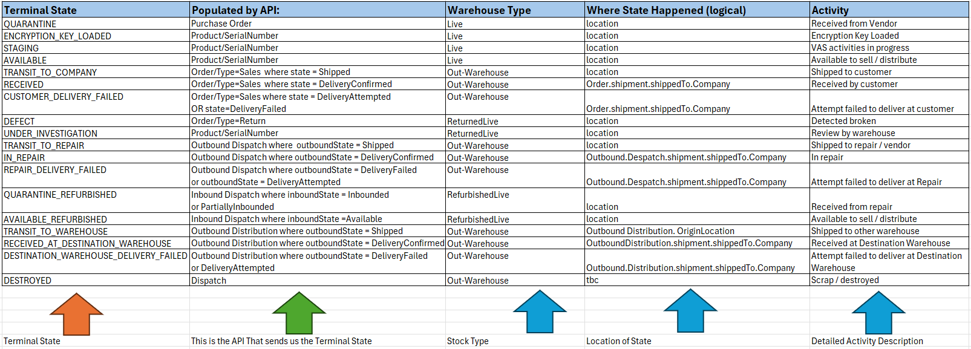
POC Terminal State (Detected in POC)
Open Items:
Statuses “Placed” and “AssignedToMerchant” (?)
Who Triggers “Destroyed”
Recommendation for TO-BE – revise by business need & include Reason codes

Slide 6
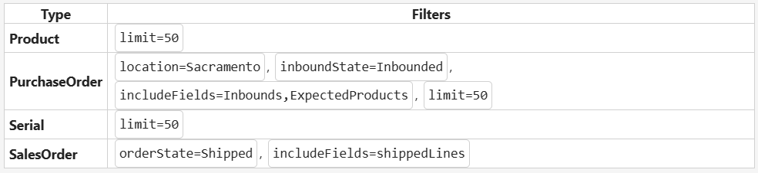
Detailed Data Mapping - POC
Logistics API:
E2MC Adapters
E2open E2MC DB
Product MD
Product/part master data
Master Data:
Product master
Suppliers &
Warehouse Locations
Manual Upload (285 parts)
TERMINAL-DISTRIBUTOR API Service
Pre processing
(1)
Only “PaymentDevice” expected for Serial number, others are dummy
Purchases:
Header
Expected Products
Inbounds [Serials]
GET /v1/purchases (inbounded) (5)
PO / PO Line info file
For Purchases – suppliers, products, locations validation
PO
TERMINAL-DISTRIBUTOR_PO_TXN
Orders:
Header
Shipment
ShippedLines
[Serials]
GET /v4/orders (shipped) (5)
Pre processing
SO / SO Line info file
TERMINAL-DISTRIBUTOR_SO_TXN
2. SO Lines
Update: STATE, date, location, refs
Product/SERIAL#:
productState per productCode / SerialNumber
GET /v2/product/xxx/serial/yyy (5)
Pre processing
Cached LOTs that are <> from Closed => xxx and yyy
3 LOT / StageSet
<DB query to all non closed LOTS>
LOT / Stage info file (4)
SERIALNUMBERLOTTRANS
Distribution:
Header
Shipment
ShippedLines [Serials]
GET /v1/distributions/inbound & /v1/distributions/outbound (3)
Pre processing
Append activities to Lot (s)
Update: STATE, date, location, refs (2)
Consistency check for serial belonging to PO is not enforced!
Distribution and Dispatch order do not have own object, their references are handled on LOT object
Both Inbound and Outbound API call processed for Distribution & Dispatch – relevant references captured
LOT / stage file processes sequence and time series serial number update (latest replace)
Filter setup:
API service and E2MC uses technical terms like Lot and Stage set, in IMS user experience it is adjusted to TERMINAL-DISTRIBUTOR terminology (serial number)
Dispatch:
Header
Shipment
ShippedLines [Serials]
Pre processing
GET /v1/dispatch/inbound &
/v1/dispatch /outbound (3)
Update: STATE, date, location, refs (2)
Process:
1. Trigger time for Purchase, Orders, Distribution, Dispatch in sequence
2. All cached Serials are queried back wards via product/serial
3. Also, all non closed LOTS from MC data base will be queried
Notes:
SerialNumber ==> /e2open/var/shared/adapters/from/TERMINAL-DISTRIBUTOR/SerialNumberSync/inbox/
SO ==> /e2open/var/shared/adapters/from/TERMINAL-DISTRIBUTOR/SOTxn/inbox/
PO ==> /e2open/var/shared/adapters/from/TERMINAL-DISTRIBUTOR/POTxn/inbox/
We did not implement:
- Inventory Reports – this info is something that IMS will be providing to the BackOffice / Looker for reporting and will be engraved together with available to Promise
- Return Order – did not contain any GET method

Slide 7
Data views & Use cases

Slide 8
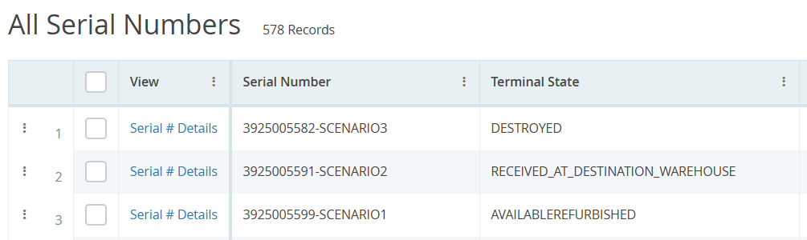
IMS Demo
Key Updates:
Display -> Saved View -> Reports -> Share
Suppliers / Locations / Part master
PO and SO reviews
Detailed view for History (Genealogy views)
Reports for Finance
Alerts & Workflows & 3PL login
Analytics (Karan)
Scenario 1 – from PO to Available to Sales order to Defect (Returned) to repair and back into available
Scenario 2 – from PO to Available to Distribution to another warehouse
Scenario 3 – from PO to Available to Sales order to Defect (Returned) and then destroyed

Slide 9
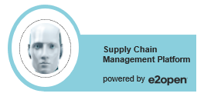
1. E2E life cycle of Terminal (Happy Flow) ​​
List: Visibility on Incoming POs
List: Received Terminal Serial nr(s)
List: Available Terminals
List: Terminal Genealogy
Key Loading failed / issue
Terminal Shipped Out
Workflow: Response
ALTERNATIVE:
Instruction: Assign Serial Nrs.
PO Receive
Serial Nr Loaded / Received WHS
Encryption Key Loading
Available Inventory
Terminal Shipped out (SO)
Terminal Delivered
Workflow: Initiate Corrective Workflow
Instruction: Print Out OR API
Physical Receiving
Staging / Key Loading / VAS
Sales Order Allocated
Delivered
PO Shipped
POD from carrier
Visibility / Action
Platform
Information / Alert
Physical Activity

Slide 10
2. Return & Repair​​
List: Terminals with Defect
List: Return & Replace
Manage Quality of Repair
List: Terminal Genealogy
Returned Terminal
Ship To Repair Centre
Workflow: Return / Replacement
Workflow: Specific Repair instructions / QA
RMA from ERP
Serial # - Out-of-Warehouse
Serial Nr Returned (RMA)
Replacement: new Serial Nr
Serial Nr. To Repair
Terminal Available (Refurbished)
Workflow: Return / Replacement
Return
Physical Receiving
Replacement Initiated
Ship out to Repair Centre
Received back from Repair Centre
Workflow: Specific Repair instructions / QA
Received @ Repair Centre
Visibility / Action
Platform
Information / Alert
Physical Activity
Note: FSL user would behave similarly as 3PL user

Slide 11
Planning & MD

Slide 12
Supply Planning with e2open
Building the foundations for TERMINAL-DISTRIBUTOR + e2open planning
Data requirements for optimal planning
Understanding your data
TERMINAL-DISTRIBUTOR planning network
Data Gaps and Next Steps
Planning TERMINAL-DISTRIBUTOR data

Slide 13
Building the foundations for TERMINAL-DISTRIBUTOR + e2open planning
Our challenge
Show that e2open is the right planning platform for TERMINAL-DISTRIBUTOR’s growth
Show we understand TERMINAL-DISTRIBUTOR’s business, supply chain complexity, and operating reality
Show we can translate TERMINAL-DISTRIBUTOR’s data and requirements into a solid planning foundation
Show we can walk this planning journey together as needs evolve
But first… any scalable supply planning journey starts with the right fundamentals.

Slide 14
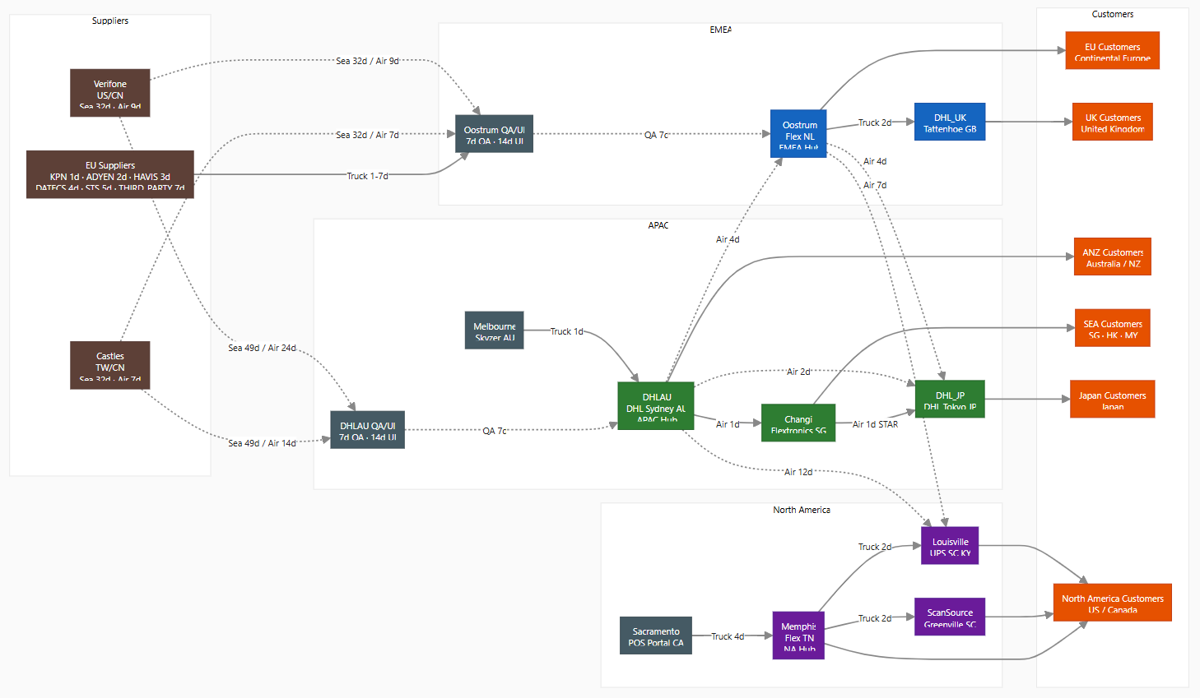
Building the foundations for TERMINAL-DISTRIBUTOR + e2open planning
*Brazil Network excluded for this demo

Slide 15
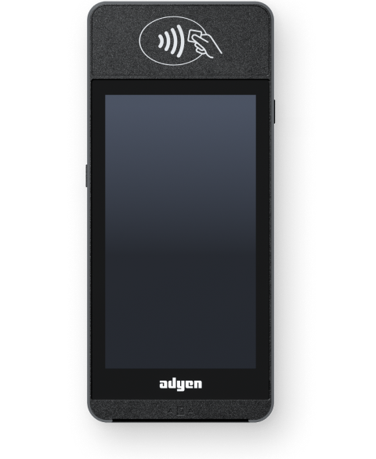
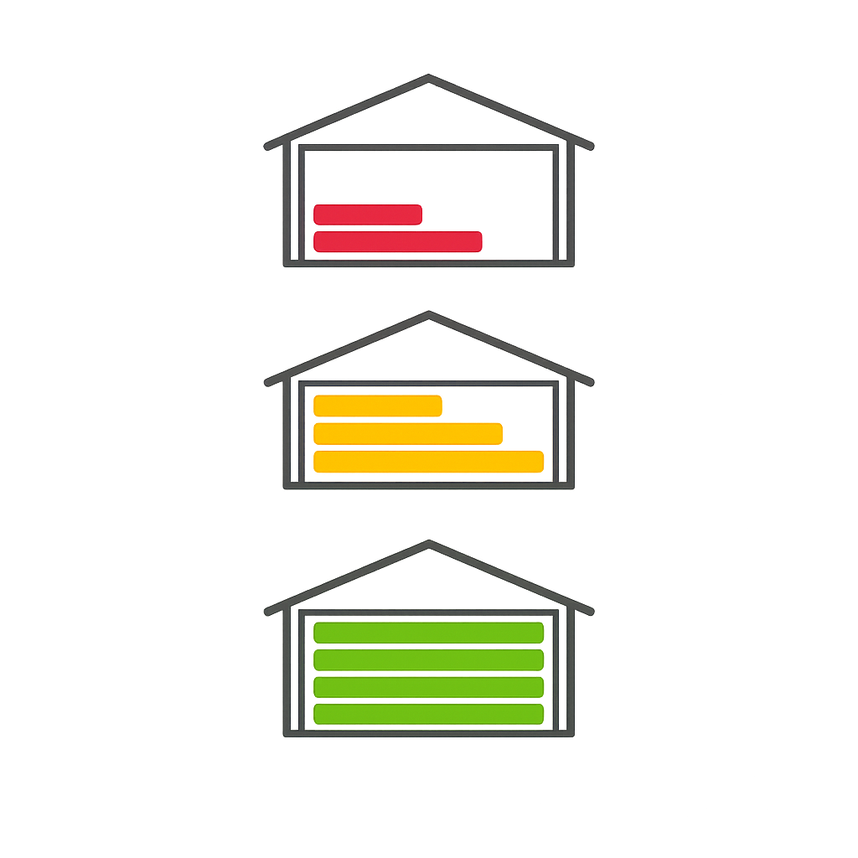
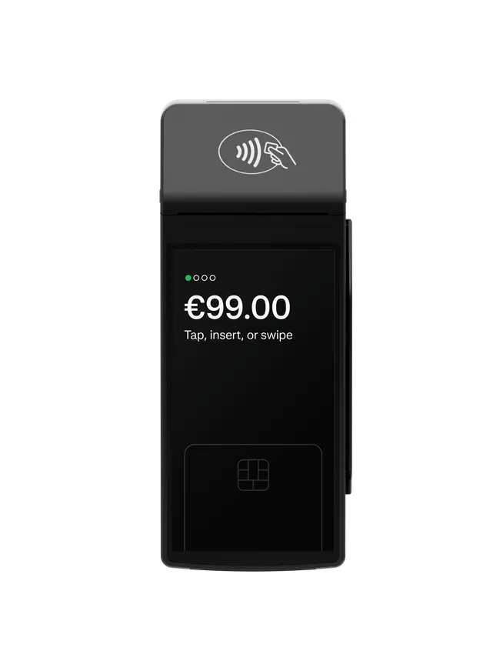
Data requirements for optimal planning
What is being planned? → Items (terminals, accessories, components)
Where does it happen?: → Item-Locations, Network (warehouses, suppliers)
How does it get there?: → Processes (buy, kitting, transfer)
How long it takes?: → Lead times
How many do we need?: → Demand
How much do we have?: → Supply (Available, non available)
How many should we keep?: → Target Inventories
What does it cost?: → Item and process cost
May | Jun | Jul
500 | 1500 | 20
Shipment Process
PO Process
External Supplier A
Warehouse | NL
3 days
Shipment Process
14 days
4€
Customer | UK
5€
Shipment Process
May | Jun | Jul
0 | 45 | 600
PO Process
FSL | UK
External Supplier B
AIR 3 days Sea 21 days
Customer | EU
14€ / 4€
3€

Slide 16
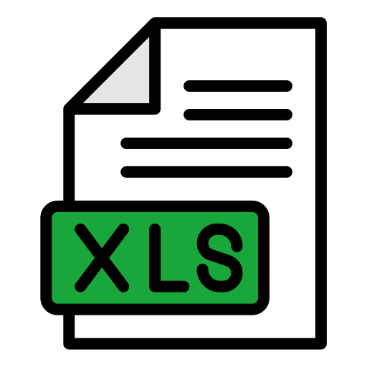
Understanding your Data – Input Files
APIs
Products — Product catalog: SKU codes, descriptions, categories, accessories
Inventory Reports — Stock levels by warehouse and product
Sales Orders — Customer orders: what was sold, to whom, when
Purchases — Purchase orders to suppliers: what was ordered, quantities, dates
Distribution Order Inbound — Warehouse transfers: origin, destination, quantities, shipment dates
Excel Files
Inventory Guide — Product master list with suppliers, families, physical attributes, and costs
Parts Master APAC — Product details for the Asia-Pacific region
ScanSource Launch Inventory — US channel partner product catalog
EMEA Stock Levels Dashboard — Current stock positions across European warehouses
APAC Stock Levels Dashboard — Current stock positions across Asia-Pacific warehouses
NA Stock Levels Dashboard — Current stock positions across North American warehouses
AfP Terminal Forecast — Forward-looking demand forecast by region and product
NA Demand Dashboard — North America demand forecast by terminal model
Large Opportunities — Sales pipeline: prospective deals by region and product

Slide 17
Understanding your Data – Building the POC Dataset
TERMINAL-DISTRIBUTOR Raw Data
Supply Planning Model
API Endpoints (5)
Automated Pipeline
486 SKUs
Products API
Transformation Engine
Items, families, substitutions, BOMs
486 SKUs, families, substitutions
9 Suppliers
Inventory API
1. Read & Parse
Lead times, modes, costs, landing points
Stock by location and state
API extracts + Excel files ingested automatically
Sales Orders API
30 Locations
Historical demand + dispatch
Physical + 20 virtual QA/UI hold nodes
Dispatch Inbound API
2. Map & Transform
12 IWT Lanes
PO receipts + serial tracking
Every field mapped to e2open Supply Planning data model format
Routes, priorities, transfer lead times
Dispatch Outbound API
Demand Signals
IWT confirmations + DO status
3. Estimate Missing Parameters
Actuals + forecast + 110 opportunities
Excel Files (6)
Missing data is estimated
Safety Stock Targets
Inventory Guide
21–60 day DOS by product family
Warehouse parameters
Parts Master
3. Validate — 69 Checks
Cost Model
Product attributes + costs
Cross-table integrity, completeness, consistency
Unit costs, freight adders, handling
AfP Forecast
4,207 Supply Processes
Forward demand by region
Opportunities
4. Generate Import Files
Ready for planning run
~110 pipeline deals
Stock Balance
30 validated Excel files — ready for e2open Supply Planning import
EMEA inventory snapshot
ScanSource Catalog
NA product catalog

Slide 18
Understanding your Data – Mapping Examples
From Transactions to Supply Chain Network definition
Network (Transport Lanes) - Distribution Order Inbound API
Each record has originLocation → destinationLocation. We extracted all unique lane pairs.
Example: Oostrum → DHL_UK appeared in 7 records → confirmed as active lane.
Lead Times (Supplier) - Purchases API
Calculated as inboundedAt (receipt date) minus createdAt (PO creation date), averaged per vendor. Example: CASTLES records → avg 7 days (AIR), 32 days (SEA).
GAP: We don’t have information about when it was shipped, only when the PO was created
Lead Times (IWT) - Distribution Order Inbound API
Estimated from carrier conventions (road/air by distance). One lane confirmed from API data (Changi→DHL_JP = 1d). Remaining 12 lanes are best-estimate assumptions. GAP: We don't have enough information to generate average transport lead times for all the lanes

Slide 19
TERMINAL-DISTRIBUTOR Supply Planning - Data Set
What this dataset is:
This planning model was built using TERMINAL-DISTRIBUTOR's real APIs and Excel files to demonstrate what e2open Supply planning can do with your actual supply chain data.
What to keep in mind:
Some parameters are estimated where source data was unavailable: lead times, unit costs, and safety stock targets. These are clearly flagged and ready for your review.
Our interpretation of your data model may not perfectly reflect internal business rules, warehouse policies, or exceptions we haven't seen yet.
What it becomes:
This dataset is the starting point, not the destination.
The path to production is a collaborative exercise: you validate, we refine, and together we build the Master Data that drives a real plan.
In production, the integration runs on E2DX, e2open's Master Data platform. The tables pre-populated from this POC become the baseline. TERMINAL-DISTRIBUTOR's team confirms and updates the values that don't live in any internal system, while the data that already exists in your systems connects automatically via API.

Slide 20
TERMINAL-DISTRIBUTOR Supply Planning Network (WIP)
Supply Chain Network – Estimated based on input data

Slide 21
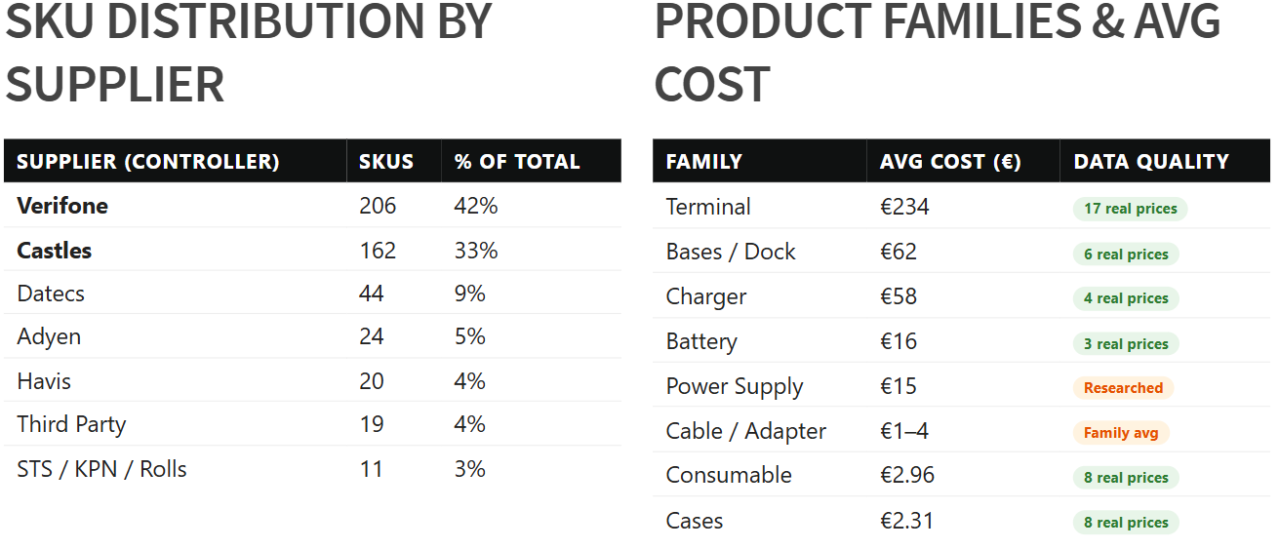
TERMINAL-DISTRIBUTOR Supply Planning Network (WIP)
Data Set Insights – Item Master (486 Active SKU)

Slide 22
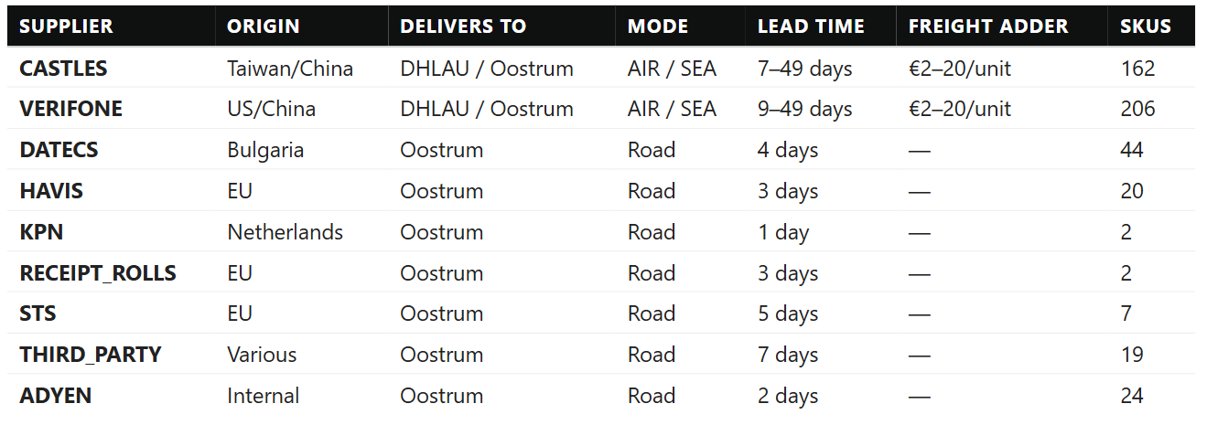
TERMINAL-DISTRIBUTOR Supply Planning Network (WIP)
Data Set Insights – Suppliers Sourcing

Slide 23
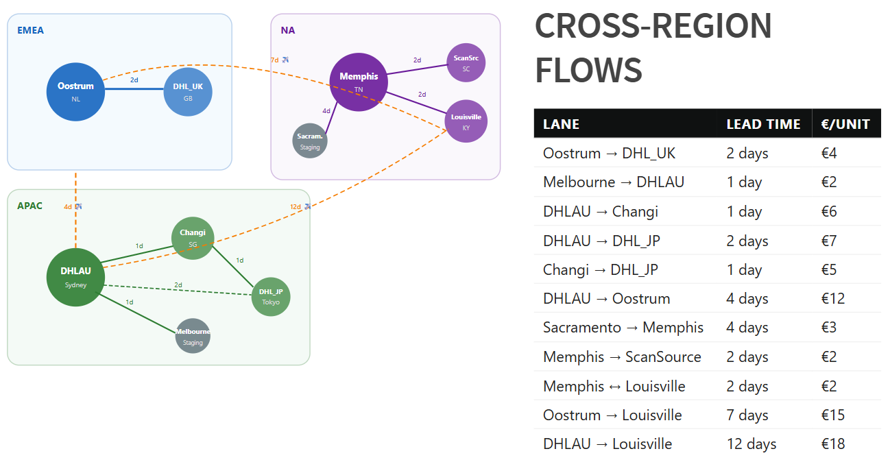
TERMINAL-DISTRIBUTOR Supply Planning Network (WIP)
Data Set Insights – Item Flow

Slide 24
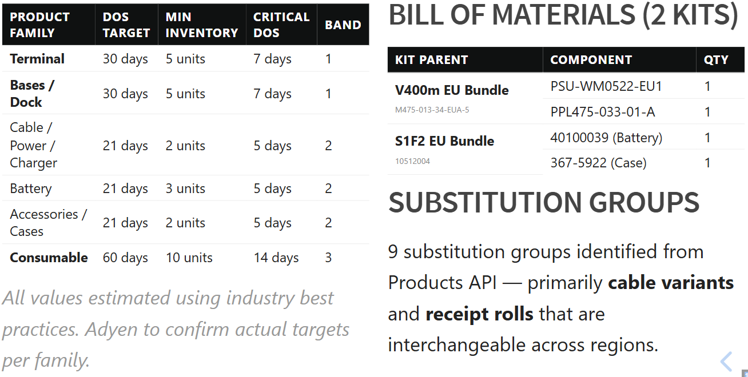
TERMINAL-DISTRIBUTOR Supply Planning Network (WIP)
Data Set Insights – Targets and Item details

Slide 25
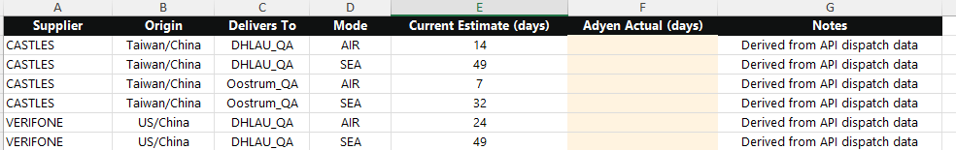
Data Gaps
What we found:
Building this dataset gave us a clear picture of what exists, what was estimated, and what is missing. The good news: the gaps are well-defined and straightforward to fill.
How we close them:
We will provide a data request workbook with one tab per topic, pre-populated with our current estimates. Your team reviews, corrects, and confirms the values that only you know.
The workbook covers: supplier lead times, IWT transit times, unit costs, safety stock policy, warehouse capacity, stock balances for APAC and NA depots, and any additional BOMs or kitting rules.
What happens next:
Once we receive the completed workbook, we regenerate the full planning model automatically. The more complete the data, the closer the output is to a production-quality plan.

Slide 26
Planning TERMINAL-DISTRIBUTOR Data - DEMO
Network Overview
TERMINAL-DISTRIBUTOR data in e2open
Inventory Projections
Inventory visibility for planning
Target Inventory
Target inventories and their effect in planning
Generate Supply Plan
What should we order/ship?

